Slide 1
App Store Simulator
By Enrico Elizan

Slide 2
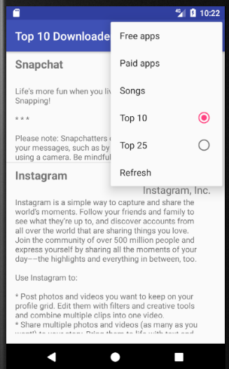
Background
Fetches and Downloads Apple’s Top apps list and displays them.
Performs asynchronous processing to handle long performing tasks.

Slide 3
AsyncTask
The AsyncTask class by definition allows the application to perform background operations and publish the results on the UI thread without having to manipulate threads and/or handlers.
Why is this important?

Slide 4
How AsyncTask Works
doInBackground
onPostExecute
@Override protected String doInBackground(String... strings) { // logs the parameter that is being passed in background Log.d(TAG, "OS read - doInBackground: Running background with: " + strings[0]); // downloads the rss and returns the feed containing the XML String rssFeed = downloadXML(strings[0]); if (rssFeed == null) { Log.e(TAG, "OS read - doInBackground: Error downloading"); } Log.d(TAG, "OS read - doInBackground: Background Done / AsyncTask Done"); return rssFeed; }
protected void onPostExecute(String s) { super.onPostExecute(s); // logs the parameter that is being passed in onPostexecute Log.d(TAG, "OS read - onPostExecute: parameter has executed the XML "); ParseApplication parseApplication = new ParseApplication(); // s is the XML parseApplication.parse(s);

Slide 5
Application Flow
1. onCreate -> AsynTask
2. Background Task -> onPostExecute
3. ParseApplication which uses FeedEntry
4. FeedAdapter to create views

Slide 6
Other Efficiency Features
Save Memory Space
Avoid Re-Downloading
// class to hold the views so we don't need to search every time private class ViewHolder { final TextView tvName; final TextView tvArtist; final TextView tvSummary; // constructor finds the id ViewHolder(View v) { this.tvName = (TextView) v.findViewById(R.id.tvName); this.tvArtist = (TextView) v.findViewById(R.id.tvArtist); this.tvSummary = (TextView) v.findViewById(R.id.tvSummary); } }
if(!feedUrl.equalsIgnoreCase(feedCachedUrl)) { // create an instance of the DownloadData class and execute Log.d(TAG, "OS read - DownloadUrl: AsyncTask Started"); DownloadData downloadData = new DownloadData(); /* note: once execute(), the asynchronous task runs through onPostExecute() and doInBackground() */ // execute will call the doInBackground method downloadData.execute(feedUrl); feedCachedUrl = feedUrl;

Slide 7
Short Demo

